Slide 1
Let’s Azure
Wriju Ghosh
Cloud Solution Architect, Microsoft
@wrijugh

Slide 2
#StartVM

Slide 3




Slide 4
Wriju.Ghosh@microsoft.com
Subject:
Stop

Slide 5
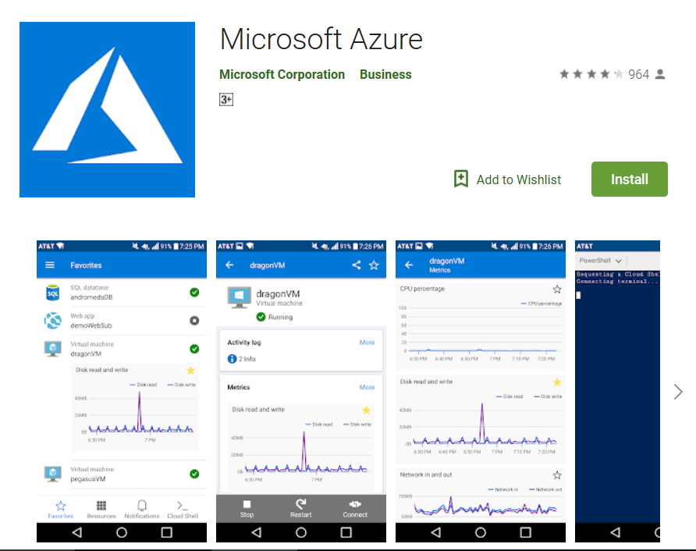
Mobile App to Manage Azure

Slide 6
Let’s learn and get recognized

Slide 7
Announcing 4 new Azure job role certifications and training
COMING SOON
Azure Administrator
Azure Developer
Azure Solutions Architect
Azure DevOps Engineer

Slide 8

Azure Apps and Infrastructure certifications
Fundamentals
Associate
Expert
Microsoft Certified: Azure Solutions Architect Expert
Microsoft Certified: Azure Administrator Associate
Microsoft Certified: Azure Fundamentals
(Optional)
COMING SOON
Microsoft Certified: Azure DevOps Engineer Expert
Microsoft Certified: Azure Developer Associate
More roles to come
Transition Exams Available:
70-532 – take AZ-202
70-533 – take AZ-102
70-535 – take AZ-302

Slide 9
Exam basics
40-60 questions
Some questions worth more than 1 point
Answer all the questions
No penalty for guessing
Some questions cannot be skipped!
Mark items for review if you’re not sure of your answer
Plan for 180 minutes
150 minutes to answer questions
30 minutes for instructions, comments, score reporting, etc.
More than just multiple-choice questions!
Build list, hot area, active screen, drag and drop, etc.
Performance based coming soon!
Case Studies
Detailed information on business and technical requirements; existing environment and other background you need to solve problems
Requires you to understand and integrate information across multiple sources, determine what’s important, and make the best decision

Slide 10
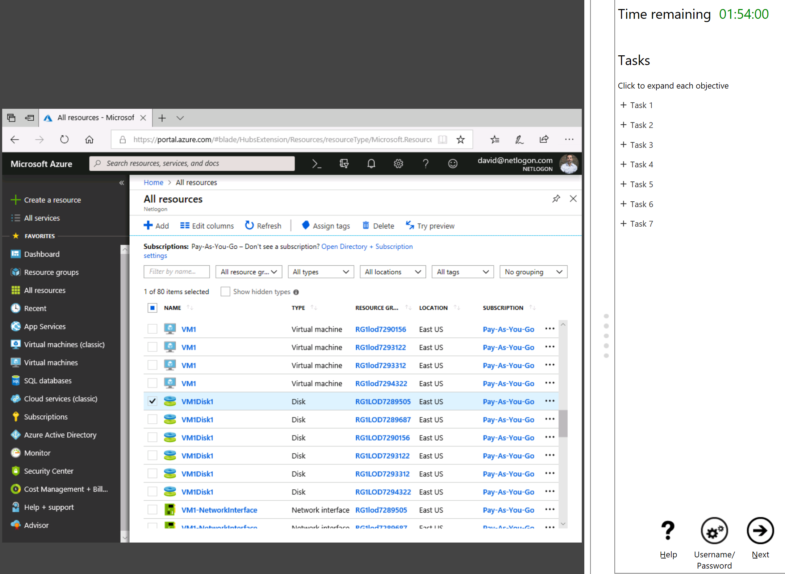

Introducing performance-based testing
Prove your skills with hands-on labs
Starting with Azure, each job role certification will have performance-based labs
Map to what you do everyday
Demonstrate your skills using the technology
At least one exam in certification will have labs; that exam have at least 2 labs with 7-9 tasks

Slide 11
Exam scoring
Each exam has a “cut score”
Scores range from 0-1000
Passing score: 700—scaled score …this is NOT 70%
Cut score determined during exam development and is updated as we maintain it
Based on skills of target audience and difficulty of item pool
Tips:
No points deducted for wrong answers
Some questions cannot be skipped!
Answer every question before moving to the next one!

Slide 12

Exam question structure
Technical environment or scenario
You are a developer…
Problem statement / requirements
The app must…
Goal statement
You need to…
Question statement
What should you do…

